Slide 1

UNIVERSITY INSTITUTE OF ENGINEERING
COMPUTER SCIENCE ENGINEERING
Bachelor of Engineering (Computer Science & Engineering)
Subject Name: Internet of Things (IoT)
Subject Code: 20CST357
INTERNET OF THINGS
DISCOVER . LEARN . EMPOWER

Slide 2
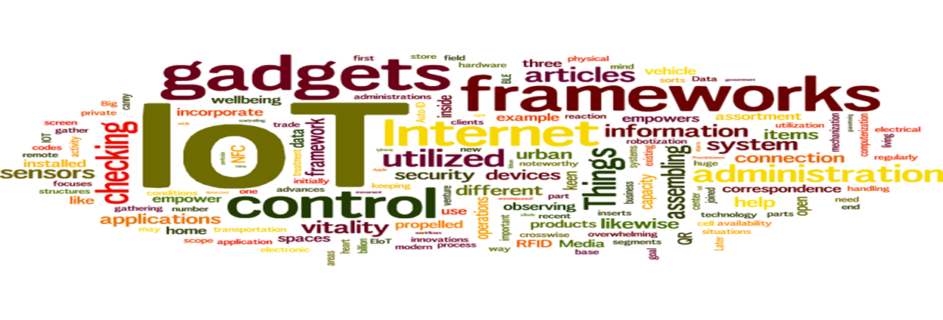
Internet of Things
Course Outcomes:
1. Analyze the basic terminologies associated with IoT and use it.
2. Justify the applications of internet of things and correlate them.
3. Compare different objects and communication strategies and also able to see the issues raised by communication strategies in IoT.
4. Examine the protocols required for communication and packet size required for each application.
5. Illustrate security issues with IoT like security, privacy, communication standard and some other legal issues.

Slide 3
UNIT 1 CHAPTER 2 IoT Applications for Industry

Slide 4
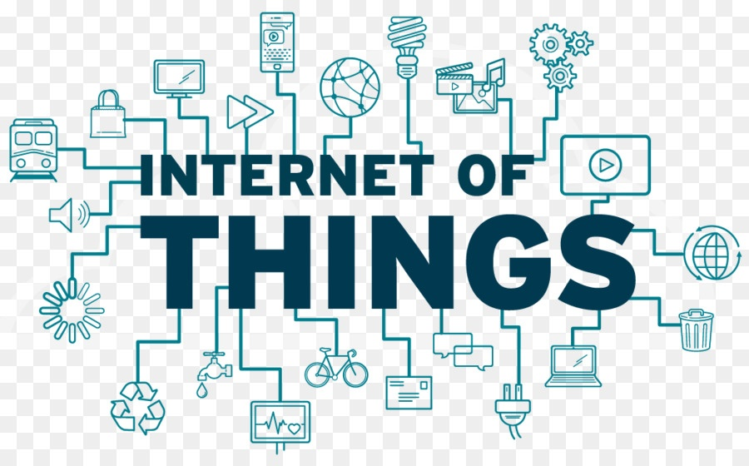
Internet of Things
Value Creation and Challenges.
IoT Today.
IoT as a Network of Networks
Why is IoT Important
IoT: Critical for human progression
Challenges and barriers to IoT.

Slide 5
Value Creation and Challenges (CO3)
Value can be generated and may show up as a result of a combination of IoT applications with other systems or processes, or can originate in new human behavior or new interactions.
An IoT enabled supply chain allows complete transparency throughout the chain, allowing individual businesses to make purchase and schedule decisions based on demand down the line. IoT's sensing and decision-making capability can also allow you to regulate power consumption based on usage.
The IoT value chain illustrates how the different components, in combination with one another or separately, add value to the overall IoT solution and, in turn, for the end user. Furthermore, each component is developed by a range of companies, some of which play several roles in the IoT value chain.

Slide 6
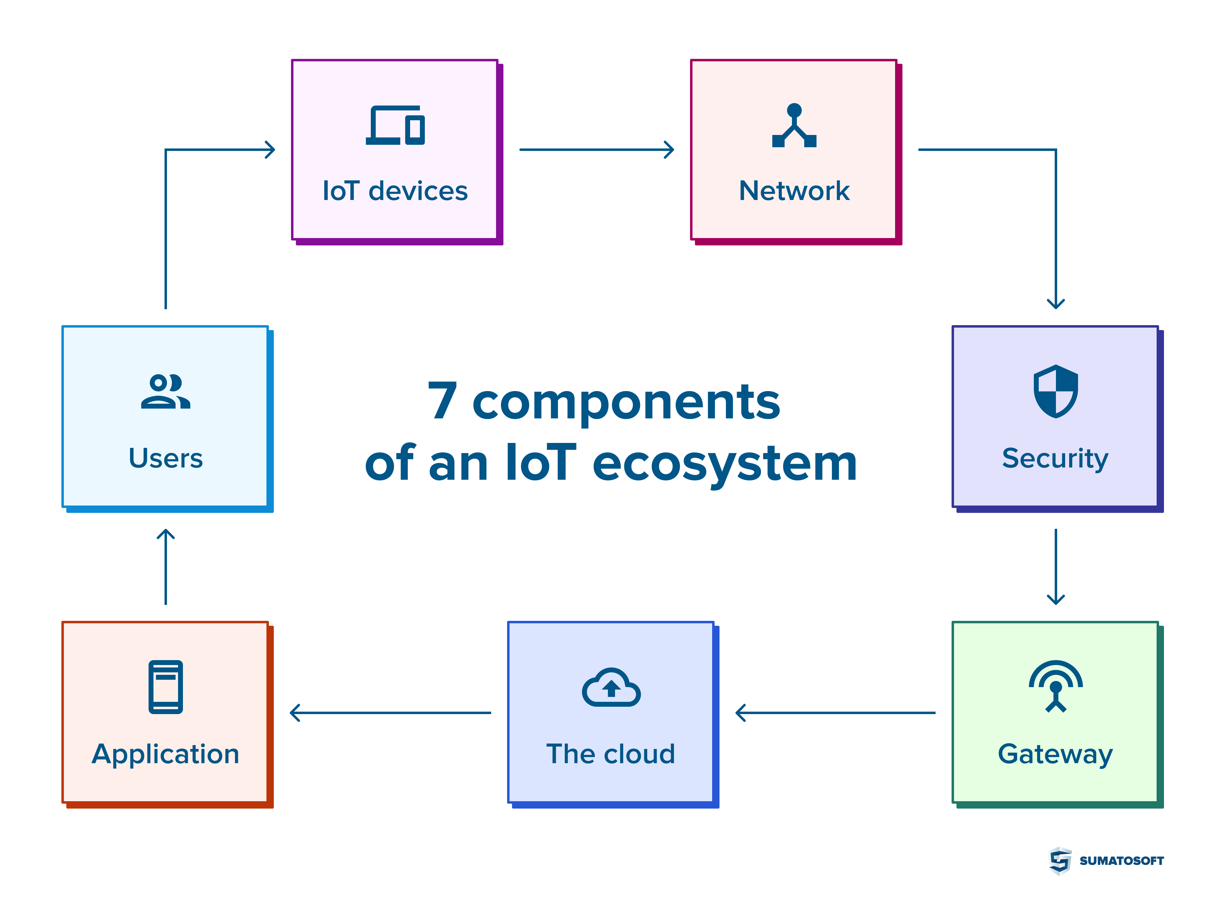

Slide 7
5 value creation layers of an IoT Application:
Layer 1 – Physical Thing
Layer 2 – Sensor / Actor
Layer 3 – Connectivity
Layer 4 – Analytics
Layer 5 – Digital Service

Slide 8
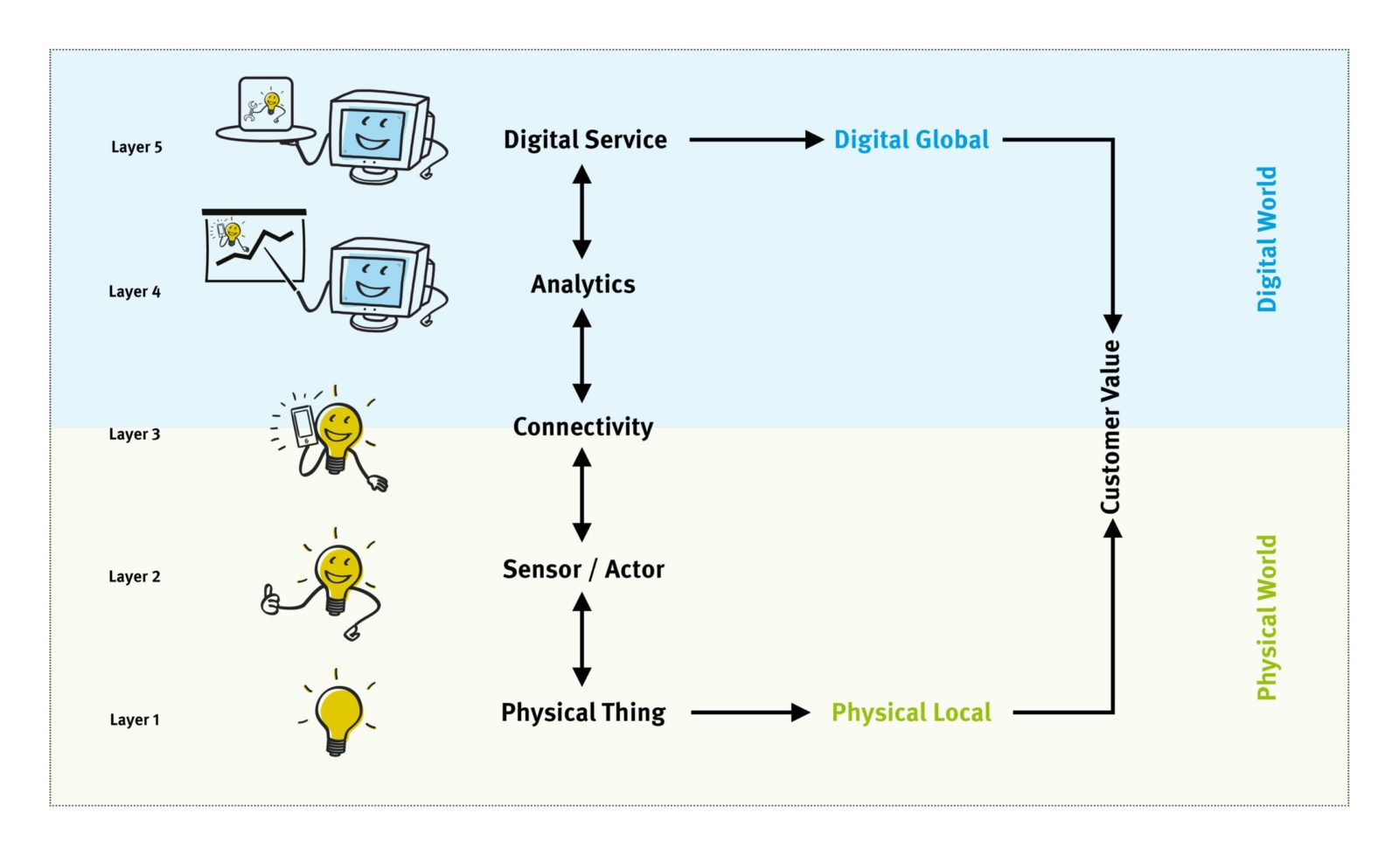

Slide 9
Crucial Elements For IoT (CO3)
Low-cost and low-power sensor technology
2. Connectivity
3. Platforms for cloud computing
4. Connectivity
5. Cross-platform capability
6. Data processing
7. Need for skill set

Slide 10
Challenges in IoT (CO-3)
Security Challenges
Lack of encryption
Lack of sufficient testing and updating
Weak login details
Design challenges
Battery sizes
System Security
Increment in cost
Timing of launch
Deployment challenges

Slide 11
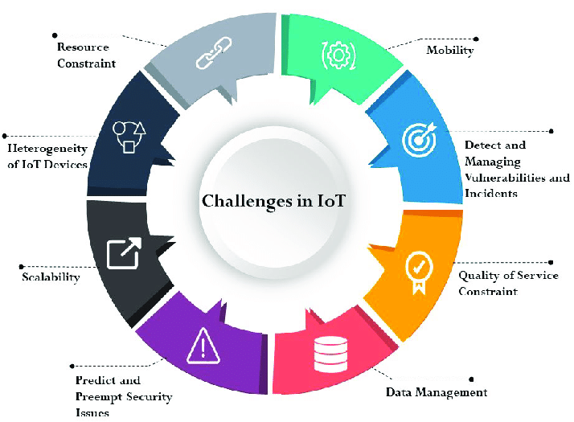

Slide 12
IoT Today (CO-2)
The Internet of Things (IoT) describes the network of physical objects—“things”—that are embedded with sensors, software, and other technologies for the purpose of connecting and exchanging data with other devices and systems over the internet.
Currently, the applications of IoT cover adverse areas including manufacturing or the industrial sector, agriculture, health sector, smart cities, security, and emergency services among many others.
With IoT, Companies can automate processes and save labor costs. It also reduces waste and improves service delivery, making it cheaper to manufacture and deliver goods and ensuring transparency in customer transactions.
The Next Generation Internet of Things (NGIoT) initiative is a growing community of projects and related initiatives at work to maximise the power of IoT made in Europe. NGIoT works to lower the barrier for adoption and development of IoT-empowered solutions, by supporting business models, innovation and skills.

Slide 13
IoT Tech Trends:
1. Remote Monitoring
2. Modular Smart Technologies Solutions
3. Data Analysis
4. Artificial Intelligence, Machine Learning, and Visual Inspection
5. Advanced Networks
6. Smart Buildings, Smart Cities
7. Digital Twins
8. Fintech

Slide 14
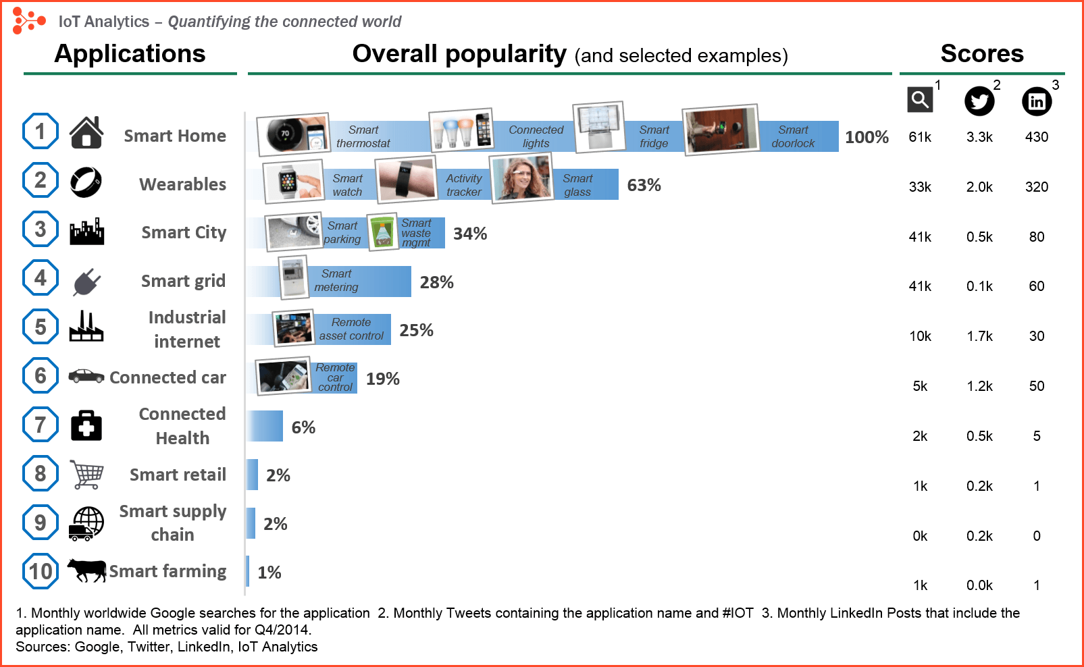

Slide 15
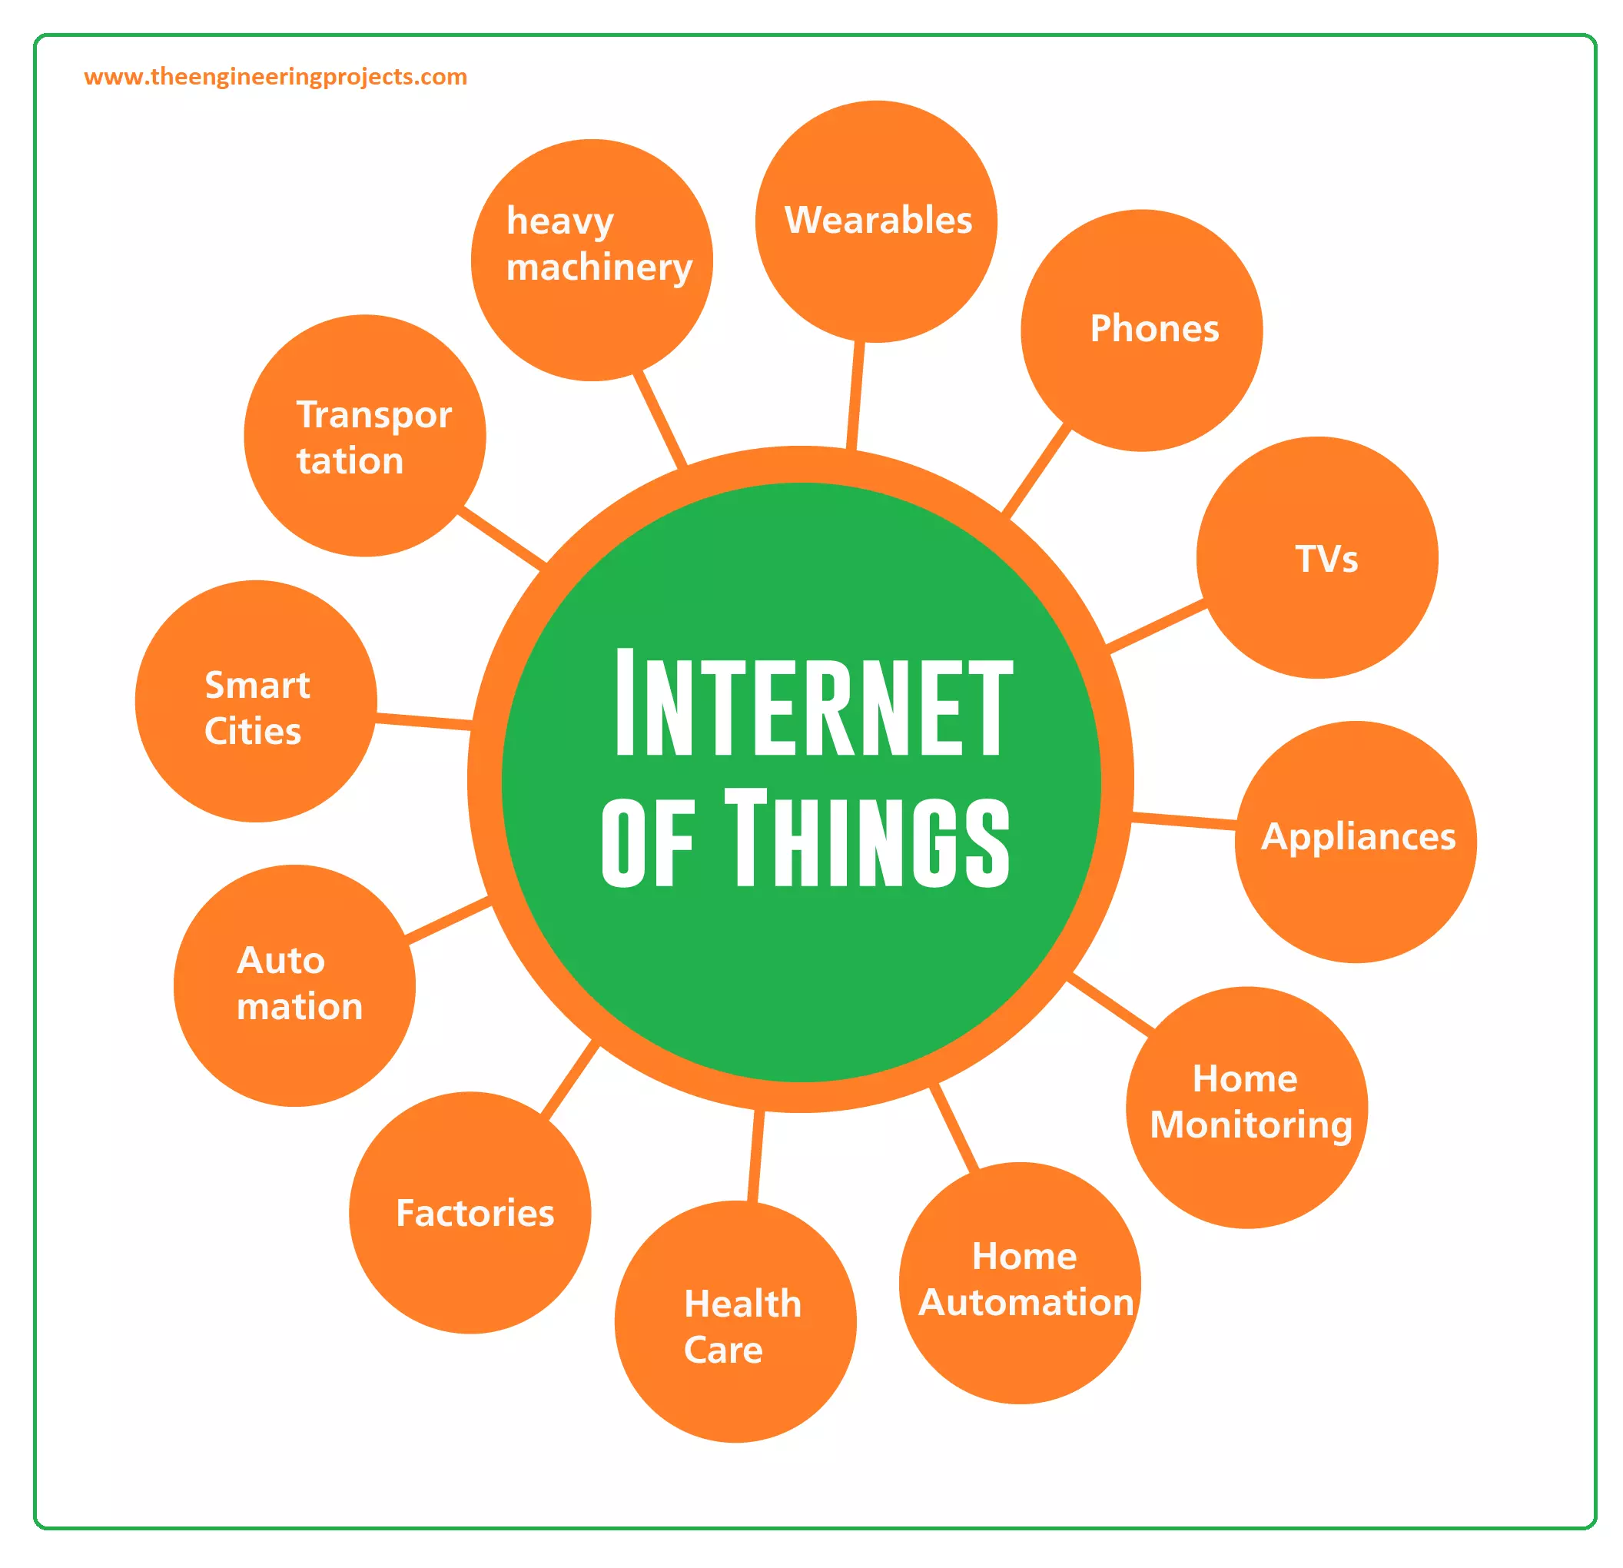

Slide 16
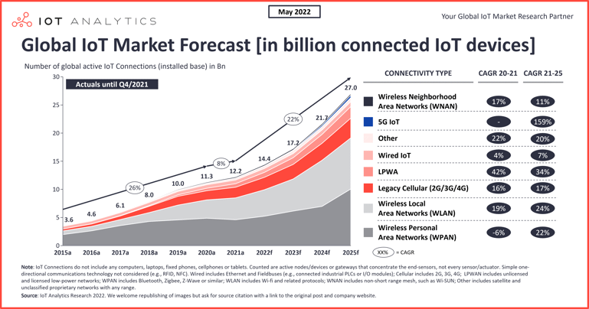

Slide 17
IoT as Network of Networks (CO3)
An IoT network refers to a collection of devices such as sensors, gadgets, appliances, and software that communicate with each other and exchange information and data without the need for human intervention.
The Internet is called a network of networks because it is a global network of computers that are linked together by cables and telephone lines making communication possible among them. It can be defined as a global network over a million smaller heterogeneous computer networks.
The internet of things, or IoT, is a system of interrelated computing devices, mechanical and digital machines, objects, animals or people that are provided with unique identifiers (UIDs) and the ability to transfer data over a network without requiring human-to-human or human-to-computer interaction.
The simplest way of explaining the Internet is to call it "the network of networks." It's the connection of computer networks around the world into one entity, so to speak. It's not one big computer, but rather numerous networked computers connected together.

Slide 18
But when it comes to evaluating what type of network connectivity is best for a given IoT solution, it can feel like there are an overwhelming number of options. Cellular, satellite, WiFi, Bluetooth, RFID, NFC, LPWAN, and Ethernet are all possible ways to connect a sensor/device.
Some remarkable examples of networks are The World Wide Web, The Internet, Power line and airline networks, Citation networks, Language networks, Food webs, Economic networks, Metabolic and protein networks.

Slide 19
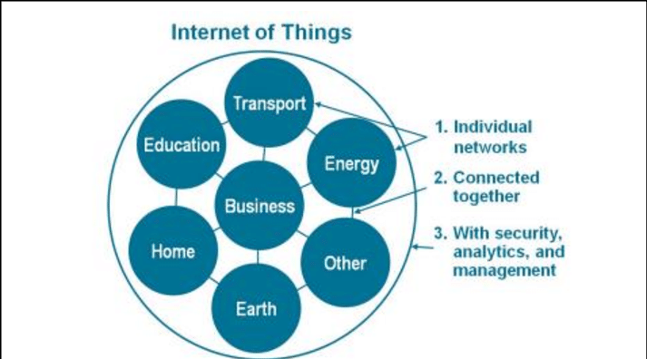

Slide 20
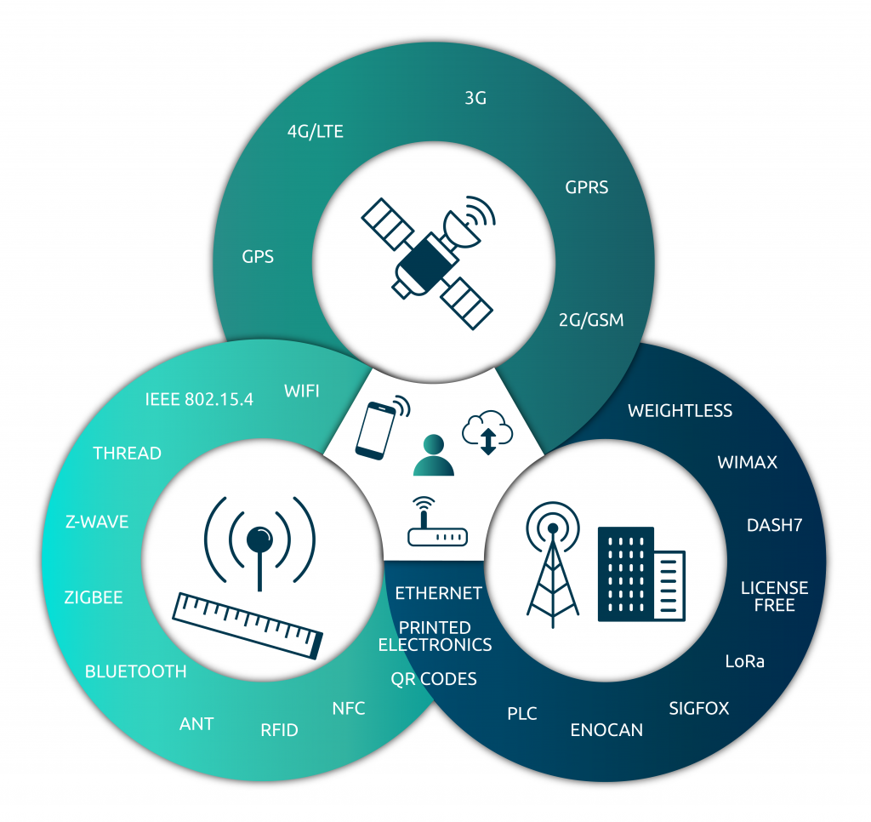

Slide 21
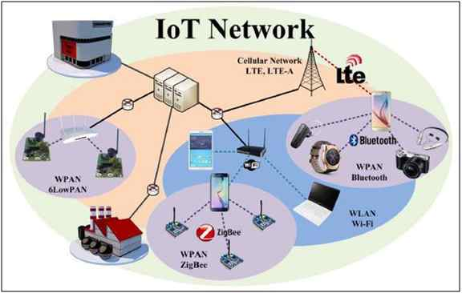

Slide 22
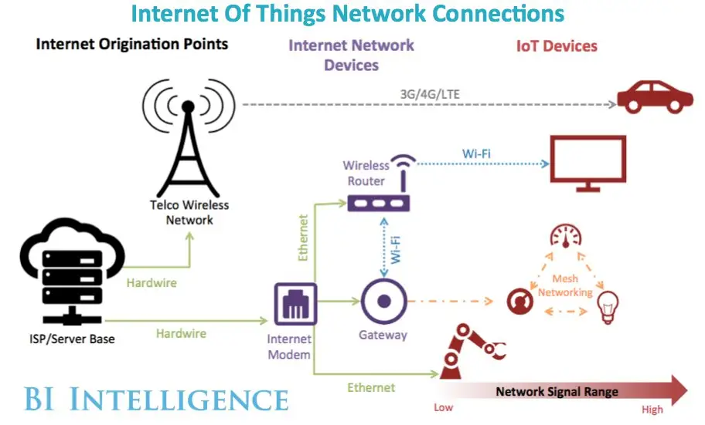

Slide 23
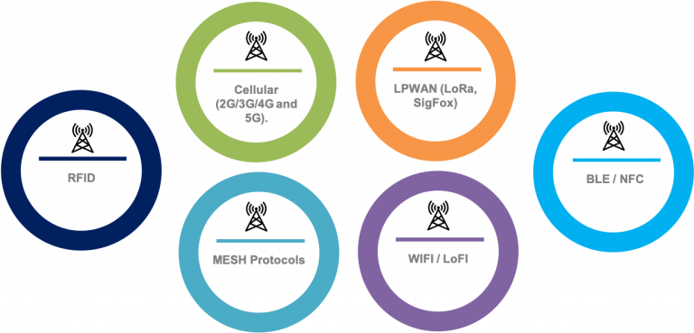
TYPES OF IoT NETWORKS

Slide 24
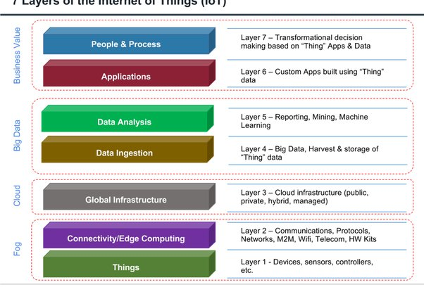
7 LAYERS OF IoT

Slide 25
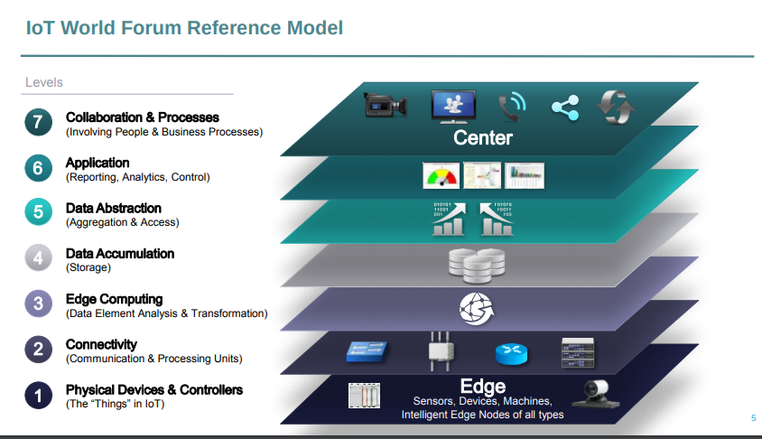

Slide 26
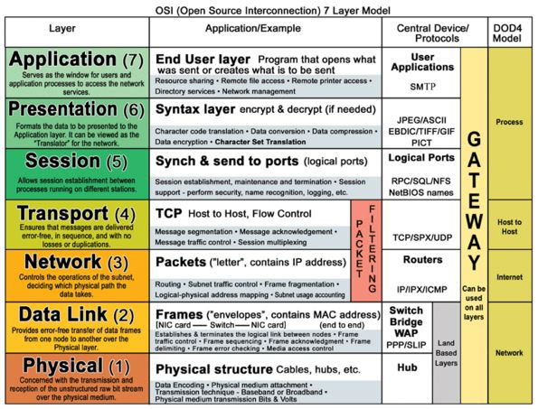

Slide 27
Why IoT is Important (CO2)
All devices that allow to gather information or to interact with other products become popular in a short period of time. Wouldn’t you like to program your laundry machine from your phone to do the laundry while you are at the supermarket?
Wouldn’t you want to get insights on how to improve your running performance thanks to smart devices attached to your body?
The Internet of Things reduces human effort for many activities, and provides tons of information. When people have data, they feel more in control of every aspect that surrounds them.
These technologies have also become more popular because of product prototype development. If an entrepreneur comes up with a great idea for an IoT product, that person can look for a company that makes prototypes, and build it with an affordable budget.
Of course, the IoT device will succeed if there is a market or problem that needs to be solved. The entrepreneur shares his vision, and the prototyping company does the rest with a professional engineering team that builds the machine or product.

Slide 28
Importance of IoT
Better life quality: Smartphones are an important part of daily life. People rely on these devices to do almost any task; from answering the phone to sending emails. Communication is something that improves the quality of life. And the IoT devices allow that.
2. Automation of processes: Turning on the lights. Opening the garage door. Adjusting the thermostat. Doing laundry. Ordering medicine. Buying groceries. Counting your burned calories during exercise. What do all these things have in common? These are activities that can be automated. Thanks to IoT devices, you could control these tasks and automate them. By installing sensors at home, you could turn on the lights from your phone, or adjust them from your app to activate at night when there is movement inside the room.

Slide 29
3. Data-driven decisions: Sean Covey, a recognized writer said, “we are free to choose our paths, but we can’t choose the consequences that come with them.” Everything in life is about decisions. IoT is important for many people because it opens up the possibility of making decisions based on the collected data.
4. Real time monitoring: These devices would have the ability to keep an eye out on the current quality of goods at home. Knowing the state of your items will allow a homeowner to know when they need to replace an item, without them having to consistently check the quality themselves. According to Markets and Markets, “The IoT based Asset Tracking and Monitoring market is projected to grow from USD 3.9 billion in 2022 to USD 6.6 billion by 2027.”

Slide 30
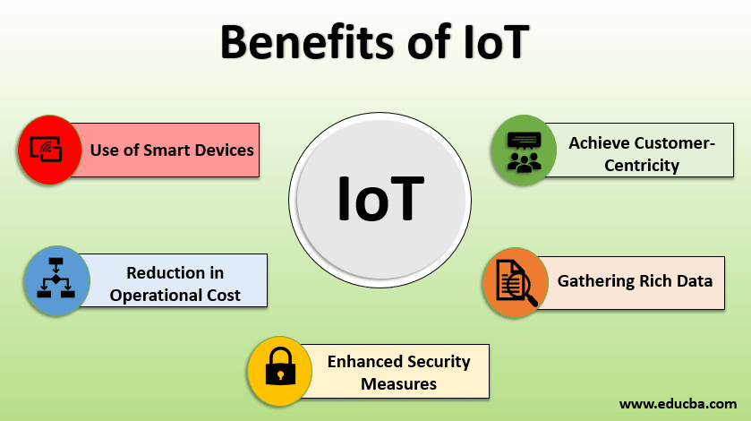

Slide 31
Need of IoT in different areas:
Smart Energy.
Smart Agriculture.
Retail.
Industrial level.
Mobility.
Health.
Smart Water.
Waste Management.
Home.
Sports.
Smart Buildings.
Logistics.
Environment.

Slide 32
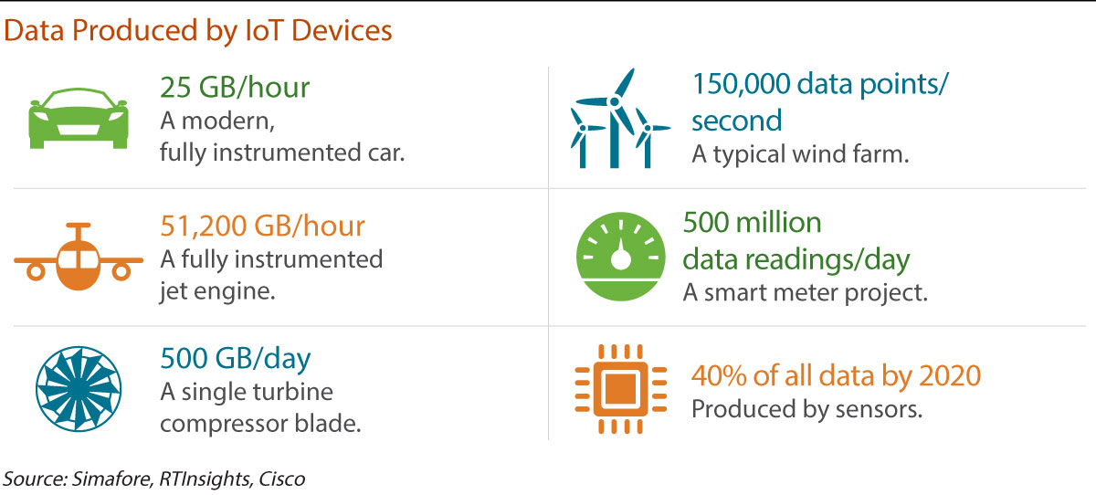

Slide 33
IoT: Critical for Human Progression (CO2)
Applying Internet of Things in a particular country or cities is a big help imagine using unique centralized system that can minimize traffic, detect crime easily or even accident can be detected in a real time with a fast response from the respective supports. It can also help strengthen our economy through machines that works autonomously without needing human intervention. All the other support will greatly describe things that are made possible by the IoT. So Connected Home, Car, Mobile Phones, and other appliances and device that can be connected a network in some way. Think of if a world of urbanized and industrialized equipped with those technologies that is interconnected together can simply help us in all our day to day activity. Even doing a laundry while doing a multi tasking activity at work and at home can be done simultaneously using this type of technology. We need to decide how much in favor of this advancement will control us . IoT improves the quality of life.

Slide 34
IoT can also solve major problems like Security Management that use sim cards or chips that can act as a sensors such as clothing with biometric sensors, facial recognition, footprint sensors, and more to increase the security of homes, offices, and buildings so with these trends it can minimize security problems like robbery or even murder. Another good thing with the IoT is can also interconnect with hospital equipment for health emergencies for example a patient with a heart ailment connected directly to the hospital can easily be addressed and save lives even in Road Traffic can minimized congested path by using an IoT sim cards such as traffic lights, smartphones, cars, GPS devices, and cameras can be used to monitor traffic patterns , inform drivers of traffic situations can easily help our enforcers , government and the constituents . Another Thing is it can also help conserved energy consumption of home or work and in terms of agricultural matters it can also support by using a sensor that can detect the environmental problems. IoT is more sophisticated but it can lead to a better life and better business opportunities.

Slide 35
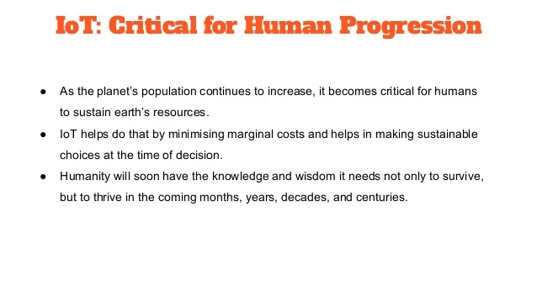

Slide 36
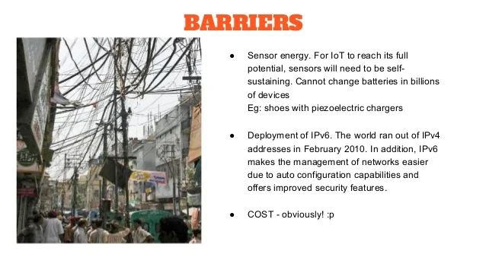

Slide 37
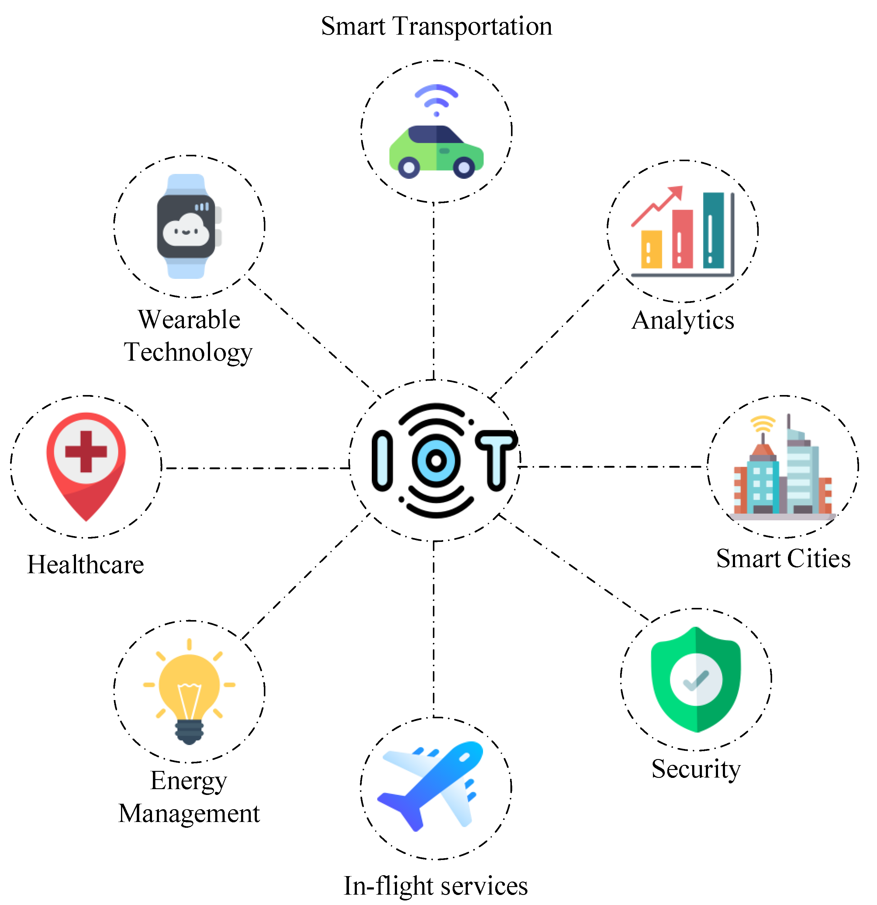
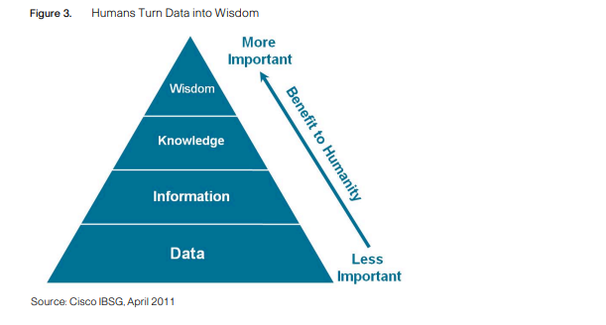

Slide 38
Challenges and Barriers to IoT (CO-3)
The Internet Of Things has been facing many areas like Information Technology, Healthcare, Data Analytics and Agriculture. The main focus is on protecting privacy as it is the primary reason for other challenges including government participation. Integrated effort from the government, civil society and private sectors would play a vital role in protecting the following values given below in to prevent IoT from getting hampered.
Scalability: Billions of internet-enabled devices get connected in a huge network, large volumes of data are needed to be processed. The system that stores, analyses the data from these IoT devices needs to be scalable. In present, the era of IoT evolution everyday objects are con interpretation of useful data.

Slide 39
2. Interoperability: Technological standards in most areas are still fragmented. These technologies need to be converged. Which would help us in establishing a common connected with each other via Internet. The raw data obtained from these devices need big data analytics and cloud storage for framework and the standard for the IoT devices. As the standardization process is still lacking, interoperability of IoT with legacy devices should be considered critical. This lack of interoperability is preventing us to move towards the vision of truly connected everyday interoperable smart objects.
3. Lack of government support: Government and Regulatory bodies like FDA should come up and bring up regulations by setting up a standard committee for safety and security of devices and people.

Slide 40
Safety Of Patients: Most Of IoT devices are left unattended, as they are connected with real-world objects. If used on patients as wearable devices, any technical error in security can be life-threatening for patient.
5. Security And Personal Privacy: There has been no research in security vulnerabilities and its improvements. It should ensure Confidentiality, Integrity and Availability of personal data of patient.
6. Design Based Challenge: With the development in technology design challenges are increasing at a faster rate. There have been issues regarding design like limited computation power, limited energy and limited memory which need to be sorted out.

Slide 41
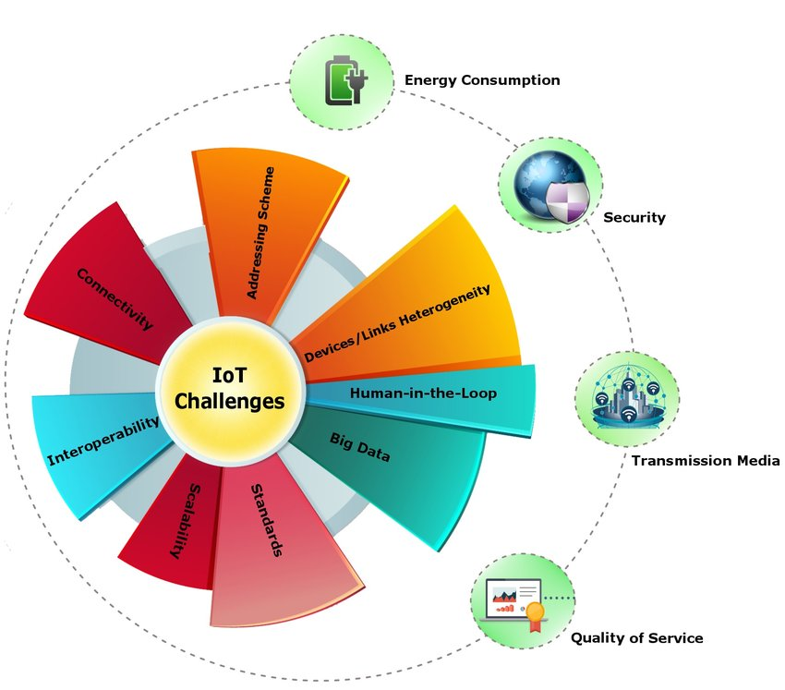

Slide 42
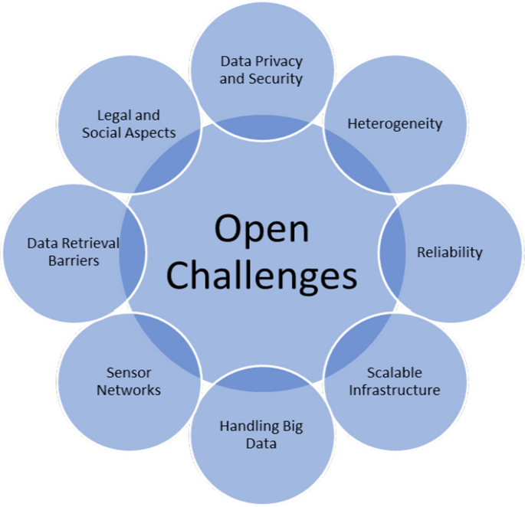

Slide 43
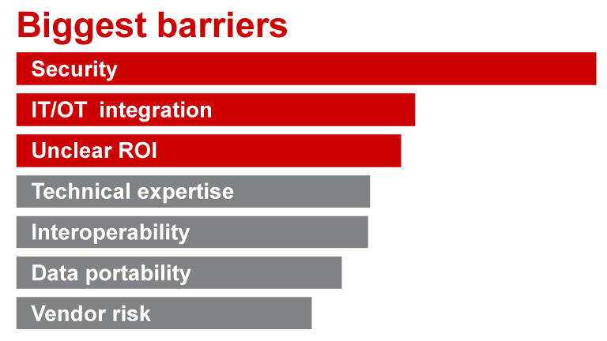

Slide 44
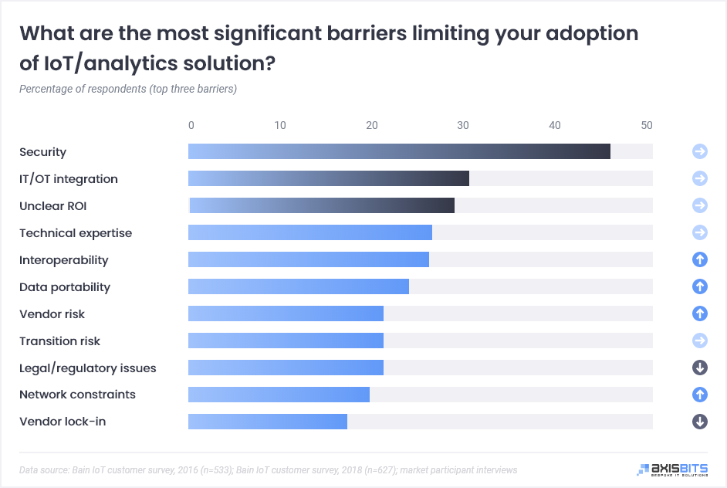

Slide 45
Summary
The internet of things, day by day accompanies the development of activities that are executed in any space, through remote access. Households and companies have included new technologies in different areas for the automatic development of activities or processes, real-time monitoring and control, which has become a pressing need for decision-making, For this reason, it is necessary to carry out a bibliographic review, by searching for scientific articles, in the most recognized digital databases, where the most important aspects of the internet of things, technologies and elements used in the last ones are mentioned years, in order to know a little more about these and their characteristics in common. For the investigation, the recommendations and analysis of the results obtained in case studies will be taken into account, seeking to leave a precedent that contributes to the improvement of the agro-industrial production processes, so that they are supported in new technologies that allow identifying, measure and control variables, that achieve the efficient operation of resources, maximizing the potential of their characteristics.

Slide 46
QUIZ
1. Which of the following is used to capture data from the physical world in IoT devices?
Sensors b) Actuators c) Microprocessors d) Microcontrollers
2. Which of the following command is used to trigger the Amazon echo IOT device?
a) Hello b) Suri c) Alexa d) Hey
3. Which of the following is false about the MANET IoT network?
(a) It is a self-configuring network (b) It has a low data rate (c) It doesn’t have any encryption (d) Power is readily available for complex security
4. Which of the following is not a sensor in IoT?
BMP280 b) DHT11 c) Photo resistor d) LED
5. Which of the following is not an actuator in IoT?
Stepper motor b) A fan c) An LED d) Arduino
6. What is the use of PWM signals in IoT development boards?
a) They are used by sensors to have analog input b) They are used by sensors to have digital input
c) They are used by actuators to have analog input d) They are used by actuators to have digital input

Slide 47
7. Which of the following is true about Arduino IoT devices?
a) They are open-source software b) They can only read analog inputs
c) They have their own operating systems d) They don’t have pre-programmed firmware
8. IoT-A stands for ________
Internet of Things Area b) Industrial of things Architecture
c) Internet of Things Address d) Internet of Things Architecture
9. Which of the following is not a feature of the Raspberry PI model B IoT device?
It has 256 MB SDRAM b) It has a single USB connector
c) It has its own operating system d) It has an Ethernet port
10. Which of the following is not related to Arduino IDE IoT software?
Serial monitor
Verify
Upload
Terminate

Slide 48
REFERENCES
TEXT BOOKS
Ovidiu Vermesan, Peter Friess, “Internet of Things-Converging Technologies for Smart Environments & integrated Ecosystem”, River Publications Netherlands.
Internet Society, “An overview of Internet of Things”.
IoT Fundamentals: Networking Technologies, Protocols, and Use Cases for the Internet of Things by David Hanes, Gonzalo Salgueiro, Patrick Grossetete, CISO Press.
REFERENCE BOOKS
Pfister, Cuno, “Getting started with the Internet of Things: connecting sensors and microcontrollers to the cloud", O'Reilly Media, Inc.”, 2011.
Greenfield, Adam,” Everyware: The dawning age of ubiquitous computing”, New Riders, 2010.
The Internet of Things, revised and updated edition (The MIT Press Essential Knowledge series) by Samuel Greengard, MIT Press.
Video Links
https://www.youtube.com/playlist?list=PLaxu2gn-9WXMf_ln5pMvxjf043jzof4-i
Web Links
https://www.the-reference.com/en/expertise/creation-and-implementation/internet-of-things
https://www.lifewire.com/introduction-to-the-internet-of-things-817766
Https://onlinecourses.nptel.ac.in/noc17_cs22/preview
https://www.intel.com/content/www/us/en/technology-provider/training/intro-to-iot.html

Slide 49
THANK YOU

